Slide 1
Jenkins
Hima Varsha Somuri
Faryal Bareen
M N Ankitha
Sujith Godavari Krishna

Slide 2
Extending with Shared Libraries
As Pipeline is adopted for more and more projects in an organization, common patterns are likely to emerge. It is useful to share parts of Pipelines between various projects to reduce redundancies and keep code "DRY" .
Pipeline has support for creating "Shared Libraries" which can be defined in external source control repositories and loaded into existing Pipelines.
Defining Shared Libraries
A Shared Library is defined with a name, a source code retrieval method such as by SCM, and a default version. The name should be a short identifier as it will be used in scripts.
The version could be anything understood by that SCM; for example, branches, tags, and commit hashes all work for Git. You may also declare whether scripts need to explicitly request that library (detailed below), or if it is present by default. Furthermore, if you specify a version in Jenkins configuration, you can block scripts from selecting a different version.
The best way to specify the SCM (Source Code Management ) is using an SCM plugin which has been specifically updated to support a new API for checking out an arbitrary named version (Modern SCM option). As of this writing, the latest versions of the Git and Subversion plugins support this mode; others should follow.
If your SCM plugin has not been integrated, you may select Legacy SCM and pick anything offered. In this case, you need to include ${library.yourLibName.version} somewhere in the configuration of the SCM, so that during checkout the plugin will expand this variable to select the desired version.

Slide 3
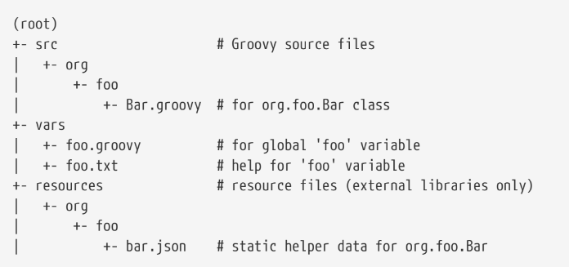
Directory structure
The directory structure of a Shared Library repository is as follows:
The src directory should look like standard Java source directory structure. This directory is added to the classpath when executing Pipelines.
The vars directory hosts scripts that define global variables accessible from Pipeline. The basename of each .groovy file should be a Groovy (~ Java) identifier, conventionally camelCased. The matching .txt, if present, can contain documentation, processed through the system’s configured markup formatter (so may really be HTML, Markdown, etc., though the txt extension is required).
The Groovy source files in these directories get the same “CPS transformation” as in Scripted Pipeline.
A resources directory allows the libraryResource step to be used from an external library to load associated non-Groovy files. Currently this feature is not supported for internal libraries.
Other directories under the root are reserved for future enhancements.

Slide 4
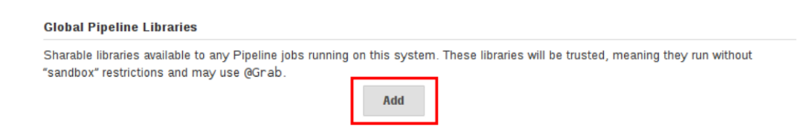
Global Shared Libraries
There are several places where Shared Libraries can be defined, depending on the use-case.
Manage Jenkins » Configure System » Global Pipeline Libraries as many libraries as necessary can be configured.
Since these libraries will be globally usable, any Pipeline in the system can utilize functionality implemented in these libraries.
These libraries are considered "trusted:" they can run any methods in Java, Groovy, Jenkins internal APIs, Jenkins plugins, or third-party libraries. This allows you to define libraries which encapsulate individually unsafe APIs in a higher-level wrapper safe for use from any Pipeline.
You need the Overall/RunScripts permission to configure these libraries (normally this will be granted to Jenkins administrators).
Folder-level Shared Libraries
Any Folder created can have Shared Libraries associated with it. This mechanism allows scoping of specific libraries to all the Pipelines inside of the folder or subfolder.
Folder-based libraries are not considered "trusted:" they run in the Groovy sandbox just like typical Pipelines.

Slide 5
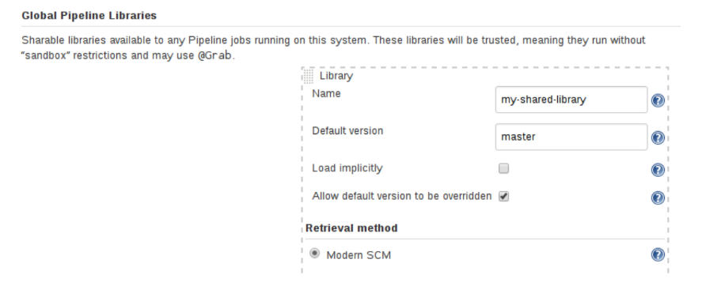
Automatic Shared Libraries
Other plugins may add ways of defining libraries . For example, the plugin:github-branch-source[GitHub Branch Source] plugin provides a "GitHub Organization Folder" item which allows a script to use an untrusted library such as github.com/someorg/somerepo without any additional configuration. In this case, the specified GitHub repository would be loaded, from the master branch, using an anonymous checkout.
Using libraries
Shared Libraries marked Load implicitly allows Pipelines to immediately use classes or global variables defined by any such libraries. To access other shared libraries, the Jenkins file needs to use the @Library annotation, specifying the library’s name:

Slide 6
@Library('my-shared-library') _
/* Using a version specifier, such as branch, tag, etc */
@Library('my-shared-library@1.0') _
/* Accessing multiple libraries with one statement */
@Library(['my-shared-library', 'otherlib@abc1234']) _
The annotation can be anywhere in the script where an annotation is permitted by Groovy. When referring to class libraries (with src/ directories), conventionally the annotation goes on an import statement:
@Library('somelib')
import com.mycorp.pipeline.somelib.UsefulClass
Libraries are resolved and loaded during compilation of the script, before it starts executing. This allows the Groovy compiler to understand the meaning of symbols used in static type checking, and permits them to be used in type declarations in the script, for example:
@Library('somelib')
import com.mycorp.pipeline.somelib.Helper
int useSomeLib(Helper helper) {
helper.prepare()
return helper.count()
}
echo useSomeLib(new Helper('some text’))
However ,Global Variables are resolved at Run time .

Slide 7
Loading libraries dynamically
There is a new option for loading (non-implicit) libraries in a script: a library step that loads a library dynamically, at any time during the build.
Syntax: library 'my-shared-library’
Thereafter, any global variables from that library will be accessible to the script.
Using classes from the src/ directory is also possible, but trickier. Whereas the @Library annotation prepares the “classpath” of the script prior to compilation, by the time a library step is encountered the script has already been compiled. Therefore you cannot import or otherwise “statically” refer to types from the library.
However you may use library classes dynamically (without type checking), accessing them by fully-qualified name from the return value of the library step. static methods can be invoked using a Java-like syntax:
library('my-shared-library').com.mycorp.pipeline.Utils.someStaticMethod()
You can also access static fields, and call constructors as if they were static methods named new:
def useSomeLib(helper) { // dynamic: cannot declare as Helper
helper.prepare()
return helper.count()
}
def lib = library('my-shared-library').com.mycorp.pipeline // preselect the package
echo useSomeLib(lib.Helper.new(lib.Constants.SOME_TEXT))

Slide 8
Library versions
The "Default version" for a configured Shared Library is used when "Load implicitly" is checked, orif a Pipeline references the library only by name, for example @Library('my-shared-library') _. If a"Default version" is not defined, the Pipeline must specify a version, for example @Library('my-shared-library@master') _.
If "Allow default version to be overridden" is enabled in the Shared Library’s configuration, a @Library annotation may also override a default version defined for the library. This also allows a library with "Load implicitly" to be loaded from a different version if necessary.When using the library step you may also specify a version:
library 'my-shared-library@master’
Since this is a regular step, that version could be computed rather than a constant as with the annotation; for example:
library "my-shared-library@$BRANCH_NAME“
would load a library using the same SCM branch as the multibranch Jenkinsfile. As another example, you could pick a library by parameter:
properties([parameters([string(name: 'LIB_VERSION', defaultValue: 'master')])])
library "my-shared-library@${params.LIB_VERSION}"

Slide 9
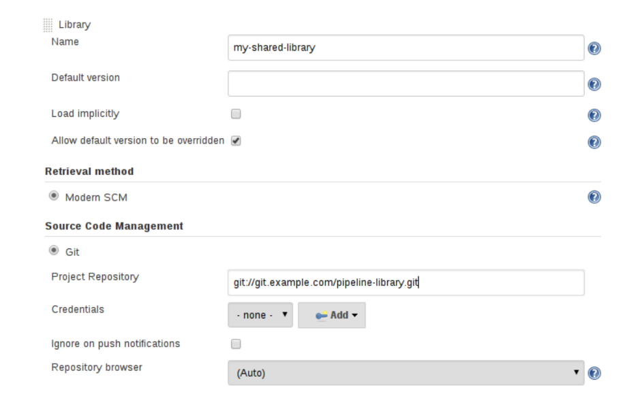
Retrieval Method
The best way to specify the SCM is using an SCM plugin which has been specifically updated to support a new API for checking out an arbitrary named version (Modern SCM option). As of this writing, the latest versions of the Git and Subversion plugins support this mode.
Legacy SCM
SCM plugins which have not yet been updated to support the newer features required by Shared Libraries, may still be used via the Legacy SCM option. In this case, include
${library.yourlibrarynamehere.version} wherever a branch/tag/ref may be configured for that particular SCM plugin. This ensures that during checkout of the library’s source code, the SCM plugin will expand this variable to checkout the appropriate version of the library.

Slide 10
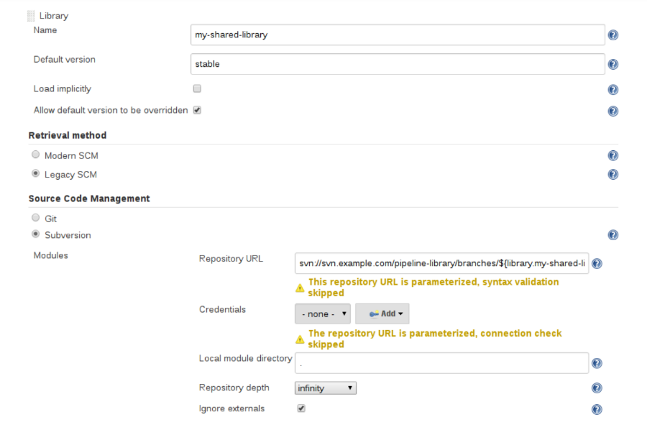
Dynamic retrieval
If you only specify a library name (optionally with version after @) in the library step, Jenkins will look for a preconfigured library of that name. (Or in the case of a github.com/owner/repo automatic library it will load that.)
But you may also specify the retrieval method dynamically, in which case there is no need for the library to have been predefined in Jenkins. Here is an example:
library identifier: 'custom-lib@master', retriever: modernSCM(
[$class: 'GitSCMSource',
remote: 'git@git.mycorp.com:my-jenkins-utils.git',
credentialsId: 'my-private-key’])
It is best to refer to Pipeline Syntax for the precise syntax for your SCM.

Slide 11


Writing libraries
// src/org/foo/Point.groovy
package org.foo;
// point in 3D space
class Point {
float x,y,z;
}

Slide 12
Accessing steps
// src/org/foo/Zot.groovy
package org.foo;
def checkOutFrom(repo) {
git url: "git@github.com:jenkinsci/${repo}"
}
Scripted Pipeline:
def z = new org.foo.Zot()
z.checkOutFrom(repo)

Slide 13
Alternately, a set of steps can be passed explicitly using this to a library class, in a constructor.
package org.foo
class Utilities implements Serializable {
def steps
Utilities(steps) {this.steps = steps}
def mvn(args) {
steps.sh "${steps.tool 'Maven'}/bin/mvn -o ${args}"
}
}

Slide 14
script being passed in to one static method
@Library('utils')
import org.foo.Utilities
def utils = new Utilities(this)
node {
utils.mvn 'clean package'
}
-------------------------------------------------------------------------
@Library('utils') import static org.foo.Utilities.*
node {
mvn this, 'clean package'
}

Slide 15
Defining global variables
def info(message) {
echo "INFO: ${message}"
}
def warning(message) {
echo "WARNING: ${message}"
}
---------------------------------------------------------------------
@Library('utils') _
log.info 'Starting'
log.warning 'Nothing to do!'

Slide 16
Use of script to access global variables.
@Library('utils') _
pipeline {
agent none stage ('Example') {
steps {
script { ①
log.info 'Starting'
log.warning 'Nothing to do!'
}
}
}
}

Slide 17
Defining custom steps
// vars/sayHello.groovy
def call(String name = 'human') {
// Any valid steps can be called from this code, just like in other
// Scripted Pipeline
echo "Hello, ${name}."
}

Slide 18
sayHello 'Joe'
sayHello()
/* invoke with default arguments */
-----------------------------------------------------------
// vars/windows.groovy
def call(Closure body) {
node('windows') {
body()
}
}
------------------------------------------------------------
windows {
bat "cmd /?"
}

Slide 19
Loading resources
def request = libraryResource 'com/mycorp/pipeline/somelib/request.json'

Slide 20
Pretesting library changes
If you notice a mistake in a build using an untrusted library, simply click the Replay link to try editing one or more of its source files, and see if the resulting build behaves as expected.
Once you are satisfied with the result, follow the diff link from the build’s status page, and apply the diff to the library repository and commit.
Replay is not currently supported for trusted libraries. Modifying resource files is also not currently
supported during Replay.

Slide 21
Defining Declarative Pipelines
Here’s an example, which will execute a different Declarative Pipeline depending on whether the build number is odd or even:
// vars/evenOrOdd.groovy
def call(int buildNumber) {
if (buildNumber % 2 == 0) {
pipeline {
agent any
stages {
stage('Even Stage') {
steps {
echo "The build number is even"
}
}
}
}
}

Slide 22
else {
pipeline {
agent any
stages {
stage('Odd Stage') {
steps {
echo "The build number is odd"
}
}
}
}
}
}
// Jenkinsfile
@Library('my-shared-library') _
evenOrOdd(currentBuild.getNumber())
Only one Declarative Pipeline can be executed in a single build, and if you attempt to execute a second one, your build will fail as a result.

Slide 23
Pipeline Development Tools
Jenkins Pipeline includes built-in documentation and the Snippet Generator which are key resources when developing Pipelines.
They provide detailed help and information that is customized to the currently installed version of Jenkins and related plugins.
•Blue Ocean Editor
The Blue Ocean Pipeline Editor provides a WYSIWYG way to create Declarative Pipelines.
The editor offers a structural view of all the stages, parallel branches, and steps in a Pipeline.
The editor validates Pipeline changes as they are made, eliminating many errors before they are even Committed.
Behind the scenes it still generates Declarative Pipeline code.

Slide 24
Command-line Pipeline Linter
Jenkins can validate, or "lint", a Declarative Pipeline from the command line before actually running it.
This can be done using a Jenkins CLI command or by making an HTTP POST request with appropriate parameters.
Examples
This example shows the output of the linter when it is passed an invalid Jenkinsfile, one that is missing part of the agent declaration.
pipeline {
agent
stages {
stage ('Initialize') {
steps {
echo 'Placeholder.'
}
}
}
}

Slide 25
Linter output for invalid Jenkinsfile
# pass a Jenkinsfile that does not contain an "agent" section
ssh -p 8675 localhost declarative-linter < ./Jenkinsfile
Errors encountered validating Jenkinsfile:
WorkflowScript: 2: Not a valid section definition: "agent". Some extra configuration
is required. @ line 2, column 3.
agent
^
WorkflowScript: 1: Missing required section "agent" @ line 1, column 1.
pipeline &#125;
^

Slide 26
In this example, the Jenkinsfile has been updated to include the missing any on agent. The linter now reports that the Pipeline is valid.
pipeline {
agent any
stages {
stage ('Initialize') {
steps {
echo 'Placeholder.'
}
}
}
}
Linter output for valid Jenkinsfile
ssh -p 8675 localhost declarative-linter < ./Jenkinsfile
Jenkinsfile successfully validated.

Slide 27
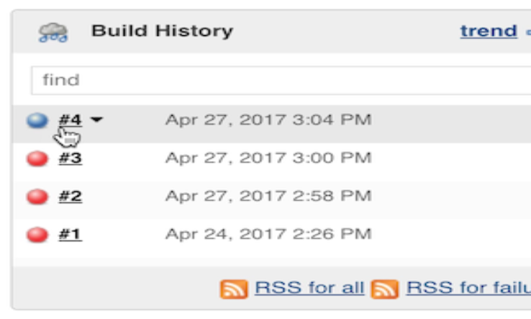
"Replay" Pipeline Runs with Modifications
Typically a Pipeline will be defined inside of the classic Jenkins web UI, or by committing to a Jenkinsfile in source control.
The "Replay" feature allows for quick modifications and execution of an existing Pipeline without changing the Pipeline configuration or creating a new commit.
Usage
To use the "Replay" feature:
1.Select a previously completed run in the build history

Slide 28
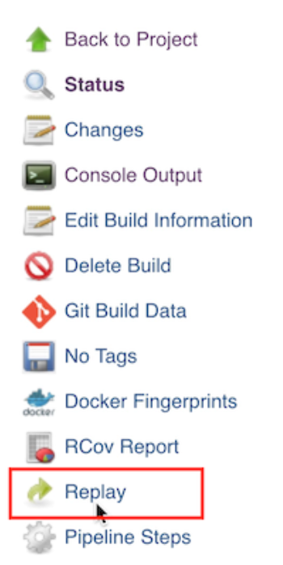
2. Click "Replay" in the left menu

Slide 29
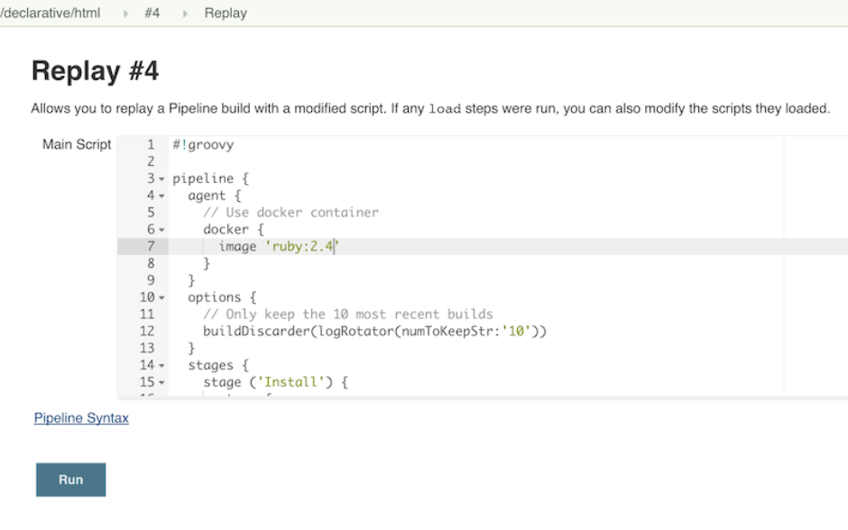
3. Make modifications and click "Run". In this example, we changed "ruby-2.3"to "ruby-2.4”.
4. Check the results of changes.

Slide 30
Features
Can be called multiple times on the same run.
Can also be called on Pipeline runs that are still in-progress.
Referenced Shared Library code is also modifiable.
Limitations
Pipeline runs with syntax errors cannot be replayed.
Replayed Pipeline behavior may differ from runs started by other methods .

Slide 31
PIPELINE UNIT TESTING FRAMEWORK
Third Party tool that allows you to unit test pipelines and shared libraries before running them in full
It provides a mock execution environment where real pipeline steps are replaced with mock objects
PIPELINE SYNTAX
Pipeline supports two discrete syntax
"STEP" tells Jenkins what to do and serve as basic building block for both declarative and scripted pipeline syntax
DECLARATIVE PIPELINE
Recent addition to jenkins pipeline which is more simplified and optionated syntax among all.
Ex : pipeline{
/* insert Declarative Pipeline here */
}

Slide 32
SECTIONS
Sections in declarative Pipeline typically contains one or more Directives or steps
AGENT
Agent section specified where the entire pipeline will execute in the jenkins environment .
The section must be defined at the top-level inside the pipeline block
PARAMETERS
AGENT section supports different types of parameters . These can be applied at the top-level of pipeline block
ANY :
Execute the pipeline / stage / any available agent .
Ex: agent any
NONE :
When we apply at the top-level of the pipeline , no global agent will be allocated for the entire pipeline and each stage section will contain its own agent section.
Ex: agent none

Slide 33
LABEL :
It will execute the pipeline / stage / agent available in the jenkins environment with the provided label.
Ex: agent{label 'my-defined-label'}
NODE:
It behaves the same as the label (agent{label 'my-defined-label'}) but node allows for additional options like customworkspace
DOCKER :
Execute the pipeline with the given container which can be dynamically provisoned on a node pre-configured to accept Docker-based pipelines.
Docker also optionally accepts an args parameter which may contain arguments to pass directly to a docker run invocation.
AlwaysPull option which will force a docker pull even if the image name is already present.

Slide 34
Ex: agent {
Docker {
Image 'maven:3-alphine'
Label 'my-defined-label'
args '-v /tmp:/tmp'
}
}
DOCKER FILE:
Execute the pipeline / stage with a container built from a DockerFile contained in the source repository .
To use this option , JenkinsFile must be loaded from a 'Pipeline from SCM" .
COMMON OPTIONS :
There are few options that can be applied two or more agent implementations.
LABEL :
A String. The label on which to run the pipeline / individual stage .
The option is valid for node, docker and dockerfile and it is required for node

Slide 35
CUSTOM WORKSPACE:
Run the Pipeline / individual stage this agent is applied to within this customworkspace .
This option is only valid for node , docker and dockerfile.
Ex : agent {
Node {
Label 'my-defined-label'
CustomWorkspace '/some/other/path'
}
}
REUSE NODE :
It is a boolean , false by default
If true , runs the container on the node specified at the top-level of the pipeline.
This option is valid for docker and dockerfile and only used on an agent.

Slide 36
Ex : pipeline {
Agent {docker 'maven:3-alphine'}
Stages {
Stage('Example Build') {
Steps {
Sh 'mvn –B clean verify'
}
}
}
}
It executes all the steps defined in the pipeline within a newly created container of the given name and tag (maven:3-alphine).

Slide 37
POST:
This section defined one or more additional steps that are run upon completion of a pipeline's or stage's run.
Post can support condition blocks like always , changed , failure , success, unstable and aborted.
These condition blocks allow execution of steps within post section depending on completion status of the pipeline.

Slide 38
THANK YOU

